Slide 1


MICROPROCESSORS GROUP 3
ADARKWA-YIADOM Nana Kwesi
ADZEWODAH Prince Samson Kodzo
Ampadu Richmond Nana Kwesi
ADDAI Samuel
AGANGMIKRE Azotegangre
ANABA Nailah Asomalis
ADDY-NETTEY Ian James
AGBEMOR Dzifa Aku
ANNAN Christabel Afedzie
ADIASE Sedem Victor

Slide 2

TABLE OF CONTENTS
Introduction
Methodology
Demonstration/Simulation
Conclusion

Slide 3

PROBLEM STATEMENT
Many drivers struggle with road safety and visibility at night due to conventional headlights that do not adapt to changing light conditions, leading to glare and accidents.
Studies show that nighttime accidents account for half of all fatal crashes in the U.S., with glare from high beams responsible for 12–15% of them.
In Ghana, most accidents occur between 18:00 and 22:00 GMT due to poor visibility.

Slide 4
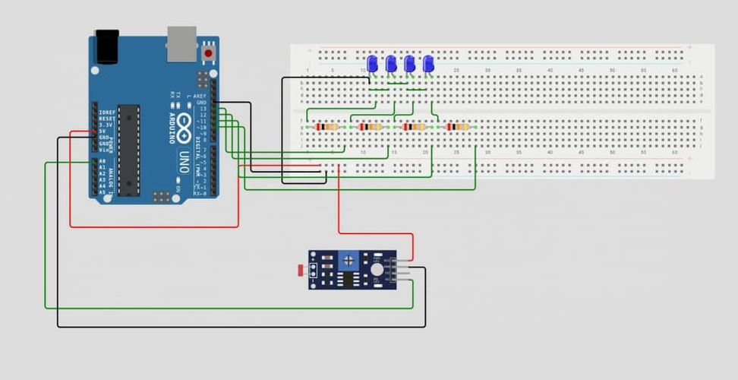
METHODOLOGY (OVERVIEW)
To address this, we have developed an intelligent headlight system using Arduino Uno, which integrates LEDs and LDRs, to detect ambient light from oncoming vehicles and other light sources and adjust brightness accordingly. This project aims to design, simulate, and develop a headlight control system that:
1. Reduces glare from oncoming vehicles.
2. Adapts to ambient light changes.
3. Enhances road visibility and nighttime safety.
4. Reduce nighttime accidents

Slide 5
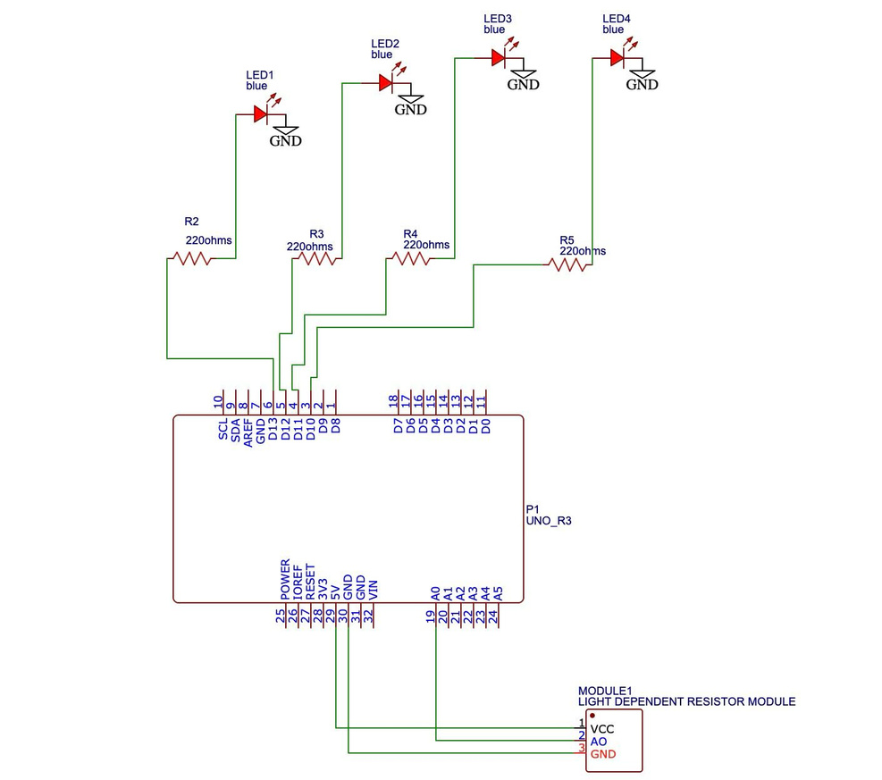
METHODOLOGY(SCHEMATIC)

Slide 6

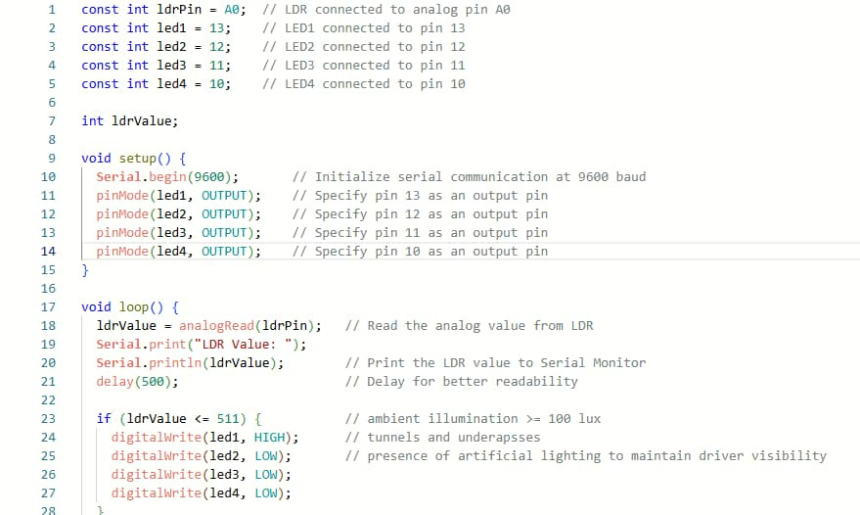
METHODOLOGY(CODE)

Slide 7

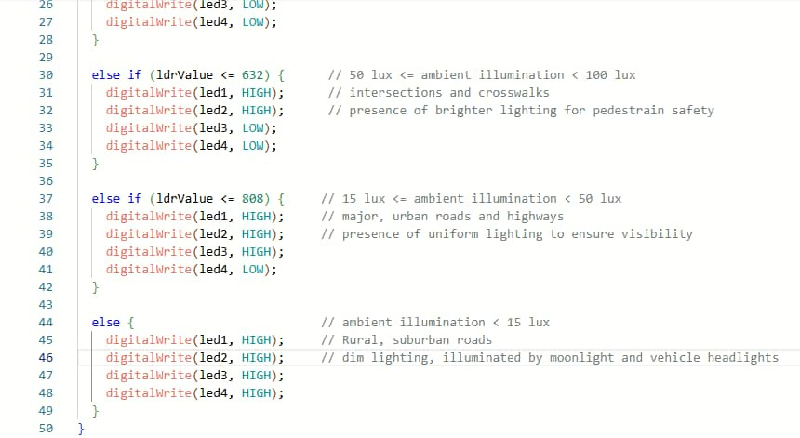
METHODOLOGY(CODE)

Slide 8

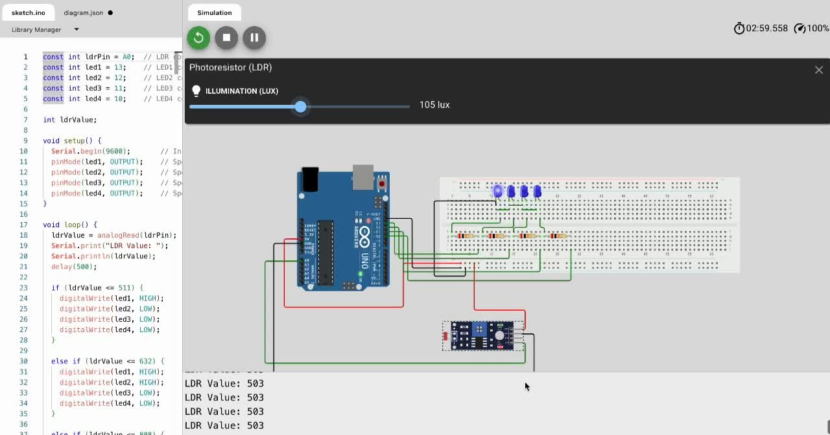
SIMULATION VIDEO

Slide 9
CHALLENGES
During implementation the following challenges were encountered:
The brightness of a single LED could not be varied so 4 LEDs were used to obtain the effect varying brightness.

Slide 10
CONCLUSION
The intelligent headlight control system enhances nighttime road safety by dynamically adjusting brightness based on ambient lighting conditions.
While this project provides a simplified implementation, further testing and integration of AI and camera-based detection could significantly improve its effectiveness in real-world applications.

Slide 11
THANK YOU

